Slide 1
Securing a Spring Web Application: PART-2
Soham Sengupta

Slide 2
From where we left yesterday
PasswordEncoder –what and why- Example?
Authentication Vs. Authorization
Concept of ROLE and ROLE based access
Enforce HTTPS
Custom User Database service
Securing Views based on ROLE of user
Intercepting requests based on IP Address (Assignment)
authenticated() Vs. fullyAuthenticated() –(Assignment

Slide 3
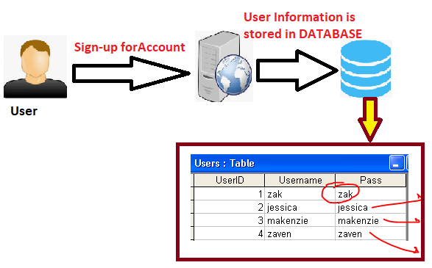

Password Encoder- Why should we avoid saving Password in Plaint-Text
Prying Eye

Slide 4
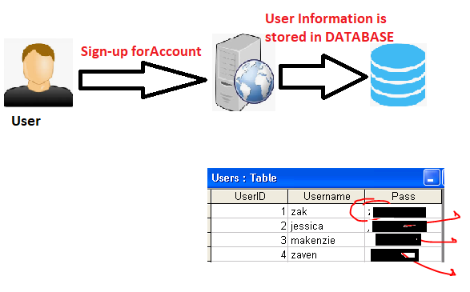
Password Encoder- Remedy- Store it as Cipher (Encrypted ) Text
DON’T store password.
Calculate a value E.g. via any function E.g. f(X) and STORE it
Login module checks if f(PASSWORD) == STORED_VALUE
Prying Eye

Slide 5
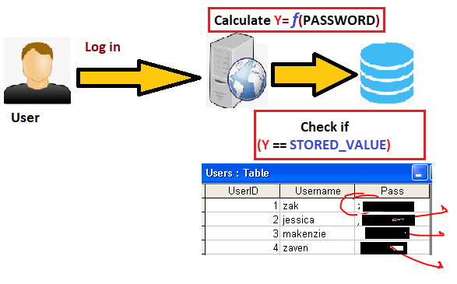

Password Encoder- Remedy- Store it as Cipher (Encrypted ) Text Cont.
Modified Log-in FLOW
Prying Eye
Attempt Login and Fail!

Slide 6
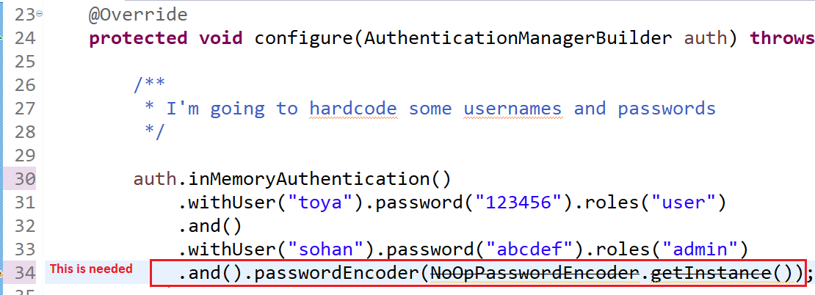
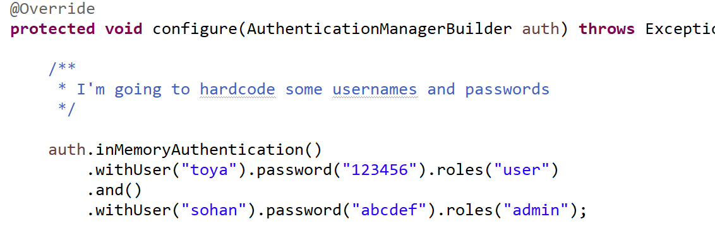
Password Encoder- Remedy- Do it The Spring-way
Spring Security -4.x Vs. Spring-security -5.x
It used to work with Spring Security-4
X It won’t work with Spring Security -5

Slide 7
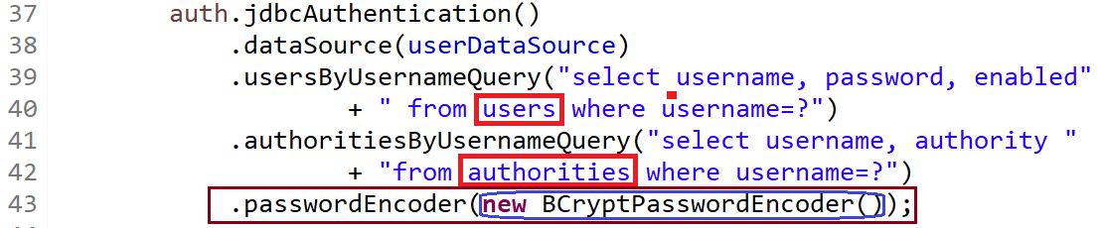
Spring- Password Encoders
NoOpPasswordEncoder (Not Secure & Deprecated)
BCryptPasswordEncoder
Let’s migrate existing code of last day from [1] to [2]

Slide 8
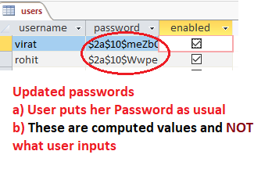
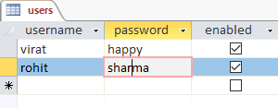
Migrate to BCryptPasswordEncoder
Pick the values of password from existing users
table – where we kept password in plain text
2. We need to keep computed values of passwords here
3. Run a program like this-

Slide 9
Authentication Vs. Authorization
Authentication→ The process of identifying a user across a system
Authorization → The process of checking whether an Authenticated user has the “legal - power” to perform something
Authorization follows Authentication
Getting Authenticated does not ensure Authorization

Slide 10
Concept of ROLE
ROLE is an identifier to decide what a User can do &what she CAN’T
We create a Spring MVC project
JdbcAuthentication
NoOpPasswordEncoder – to keep it simple and focus on ROLE only.
Let’s assume that we have 2 types of users:
Type-1 : Let’s call them ADMIN- who can access all pages
Type-2 : Let’s call them EMP –who can access requests /emp/**
Both these two types of users can access OPEN pages

Slide 11
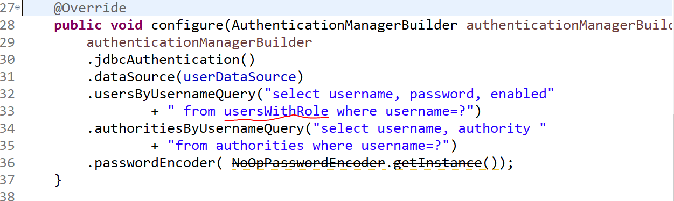
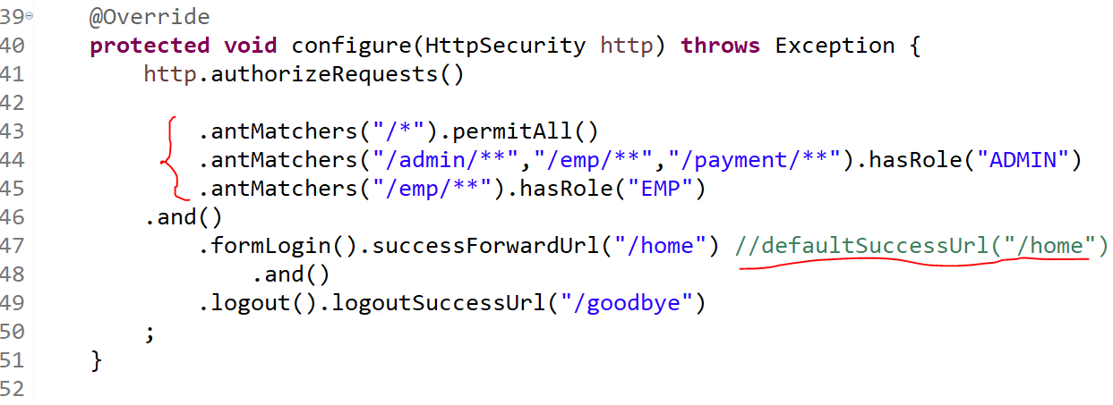
Code Snippet

Slide 12

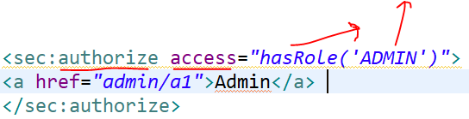
Securing View by Spring TAGLIB
In previous example, for all users the hyperlinks were display
They were, however, not accessible unless you were logged in as ADMIM
But, you might have to render the View according to ROLE of the user
Add Spring Security TAG library

Slide 13

Require HTTPS /TLS
Some pages contain sensitive information
Credit Card information
Password
Etc.
These must be prevented from Man-in-Middle attack – Use TLS (https)
Spring can enforce channel to use HTTPS

